Slide 1
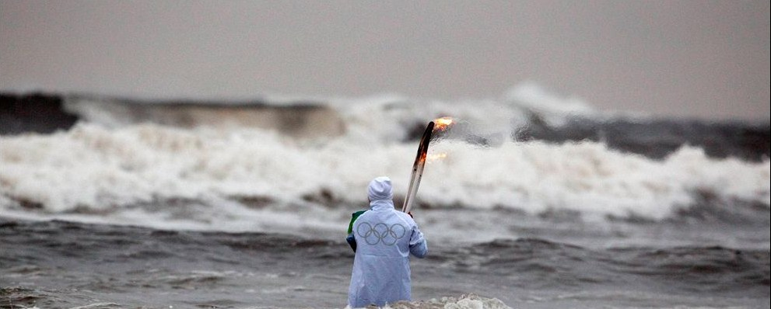
The Protection Games Qui Tam Olympics Rigsby Qui Tam
State Farm’s Motion for Protective Order
State Farm’s Memorandum in Support of Motion for Protective Order

Slide 2
Summary of Argument State Farm’s Memorandum in Support Motion for Protective Order Rigsby Qui Tam
“The Court has repeatedly instructed the parties that “[t]he
trial of this case will be limited to the McIntosh claim”
September 24, 2009 Order [363], i.e., the claim of Thomas
C. and Pamela McIntosh for flood damage to their residence
at 2558 South Shore Drive, Biloxi, Mississippi that State Farm
paid and for which State Farm was reimbursed by the NFIP.
Relators Cori Rigsby and Kerri Rigsby (“the Rigsbys”),
however, continue to attempt to expand the area of inquiry
by asking for discovery on claims that bear no relation to the
McIntosh flood claim…”

Slide 3
Conclusion of Argument State Farm’s Memorandum in Support Motion for Protective Order Rigsby Qui Tam
In order to keep the case from spiraling off into the
numerous “mini-trials” that the Rigsbys’ requested discovery
regarding engineering reports and other information from
non-McIntosh homeowners and flood claims would
necessarily invite, State Farm requests the Court to grant its
Motion for Protective Order, absolving State Farm from the
responsibility of responding to Interrogatories Nos. 4 and 11
and Document Requests Nos. 2, 11, and 12, and ordering the
parties hereto to limit the scope of discovery to materials and
information related to the McIntosh flood claim, heretofore
identified by the Court as the sole subject matter of this
case.

Slide 4
April 20, 2009 Order Federal District Judge L. T. Senter, Jr. Rigsby Qui Tam
…the Court believes that Defendants
should not be in control of limiting
the areas of inquiry.

Slide 5
State Farm’s Objections
Memorandum in Support of Motion for Protective Order

Slide 6
State Farm’s Memorandum in Support Motion for Protective Order Rigsby Qui Tam
Interrogatory #4
State Farm’s Objection
Identify each engineering report
prepared by Forensic for which
State Farm challenged or
disputed in any way the final
written report.
For each engineering report identified
state the insured’s name, address,
and policyholder number, explain the
subject of the dispute, and state
whether Forensic supplemented its
report or provided a new report for
that claim.
Interrogatory No. 4 thus seeks
information from other homeowners
claim files and has no bearing on
whether there was an overpayment of
the McIntosh flood claim as a result
of a knowingly false submission to
the federal government by State
Farm.
Additionally, Interrogatory No. 4 asks
for confidential policyholder
information which, if answered,
Implicates the right of privacy of
State Farm policyholders.

Slide 7
State Farm’s Memorandum in Support Motion for Protective Order Rigsby Qui Tam
Interrogatory # 11
State Farm’s Objection
Describe your procedures for using
engineering reports for adjusting claims for
damage caused by Hurricane Katrina.
In answering this interrogatory, explain the
type of claims for which engineering
reports were ordered, whether, if ever you
cancelled engineering reports after they,
had been ordered, and your procedures
for handling, reviewing, and filing
engineering reports once they were
received and should state whether any of
these procedures varied by office or state.
Like Interrogatory No. 4, Interrogatory No.
11 seeks information that is well beyond
The McIntosh flood claim.
For instance, Interrogatory No. 11 requests
information regarding whether engineering
reports were ever cancelled,
notwithstanding that it is undisputed that
there was no cancellation of an
engineering report in connection with the
McIntosh homeowners claim and no report
was ordered in connection with the
McIntosh flood claim.

Slide 8
State Farm’s Memorandum in Support Motion for Protective Order Rigsby Qui Tam
Document Request # 2
State Farm’s Objection
All documents related to
your adjusting of claims
under flood policies or
homeowner policies for
properties located within a
half mile of the McIntosh
home. The request includes
but is not limited to complete
copies of the flood file and
homeowner file for each such
claim.
This request not only seeks
information concerning
State Farm policyholders
other than the McIntoshes,
it also seeks information
related to the adjustment of
other homeowners claims
which have nothing to do
with the McIntosh flood
claim.

Slide 9
State Farm’s Memorandum in Support Motion for Protective Order Rigsby Qui Tam
Document Requests
#11 & 12
State Farm’s Objection
All documents related to use of engineers in
assessing damage caused by Hurricane Katrina.
This request includes but is not limited to any
decisions to order or cancel multiple engineer
reports, and decisions to order or cancel
engineer reports on a blanket or categorical basis.
All documents related to the procedures used by
engineers to assess damage caused by Hurricane
Katrina. This request includes but is not limited to
The procedures for handling finished engineering
reports and any instructions given to engineering
firms related to how to conduct an engineering
analysis including the use of eye witness
testimony, distinguishing between damage caused
by wind and damage caused by water, and
describing the damage sustained by a home.
As with Interrogatories Nos. 4
and 11, Document Requests Nos.
11 and 12 seek information
regarding procedures and
engineering reports from claims
made by State Farm
Policyholders other than the
McIntoshes, almost exclusively in
connection with homeowners’
claims, and that are otherwise
unrelated to the McIntosh flood
claim.

Slide 10
Sources and Resources
State Farm's Motion for Protective Order with Memorandum of Support (Rigsby Qui Tam)
Defendants' Proposed Discovery Plan (Branch Qui Tam)
Condoms in the courtroom – State Farm wears protection, wants to %#!# you!
If you don’t stand for something you’ll fall for anything – Plaintiffs’ growing opposition to State Farm Protective Orders
What’s the score? 0 – 2 on tail-wagging-dog Protective Orders
Pinocchio’s nose – State Farm Protective Orders
About that State Farm shredder truck
USA ex rel Rigsby v State Farm - an analysis of the McIntosh claim updating the original post Not to belabor the point

Slide 11
Coming Next on Slabbed!
The Protection Games Qui Tam Olympics
Part 2: Branch Qui Tam

